Slide 1
Merge Task 1+2
<
1/10
>
+
Joe Doe:
6
6
-
Basics
Adresses
Others

Slide 2

Task 3: Confirmation Popover
Remove Joe Doe?
<
1/10
>
+
Joe Doe:
6
6
-
Confirm
Cancel
Basics
Adresses
Others

Slide 3
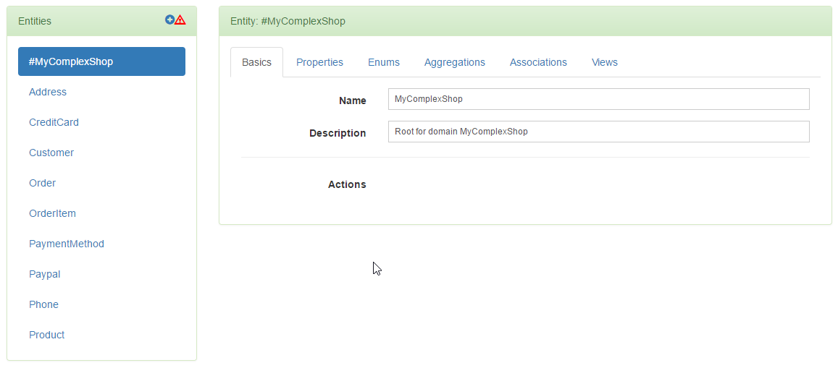
Inline Menu
Task 4: Preview East
<
1/10
>
+
Menu for Pagination

